Slide 1
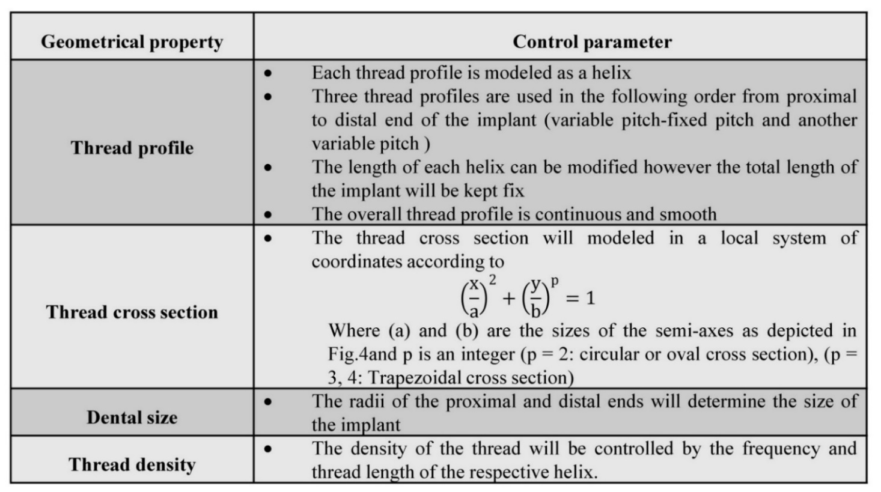
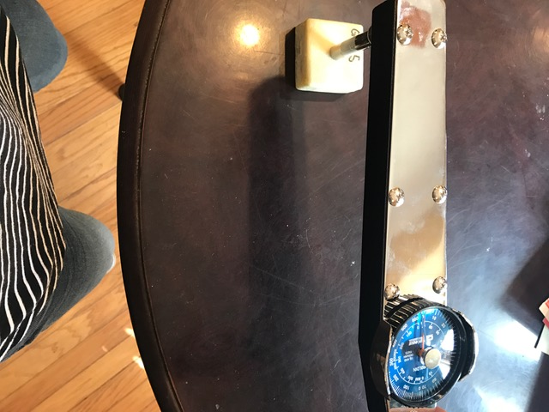
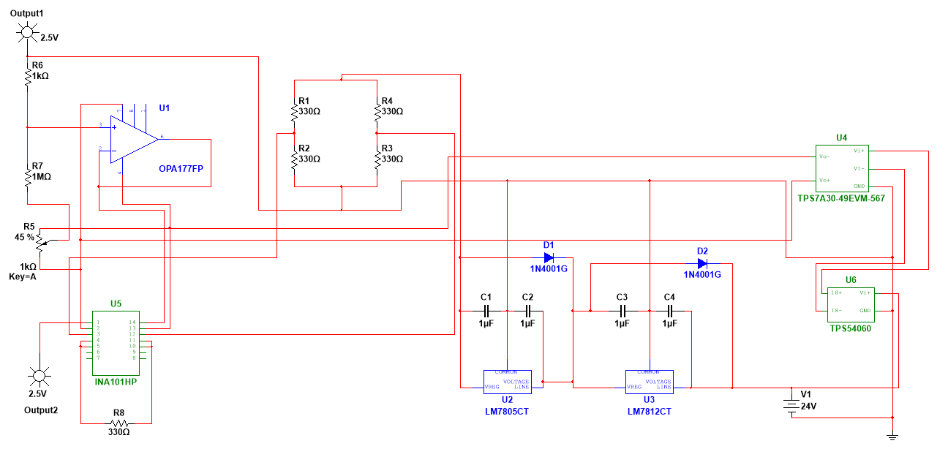
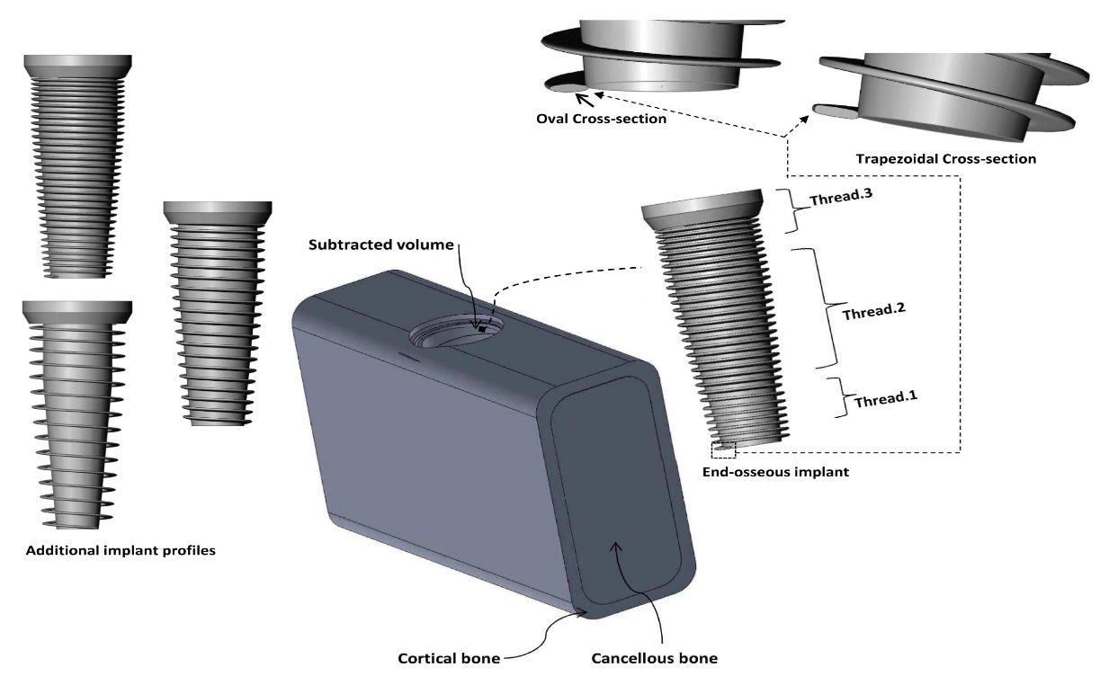
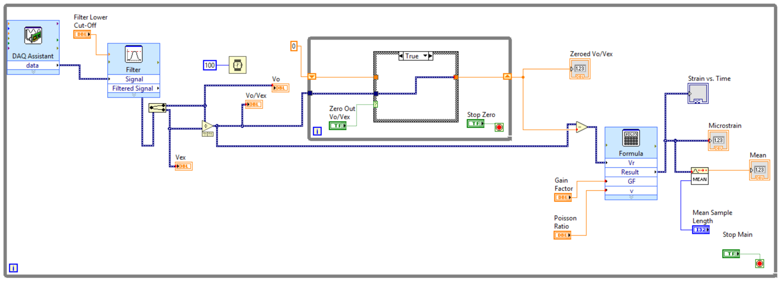
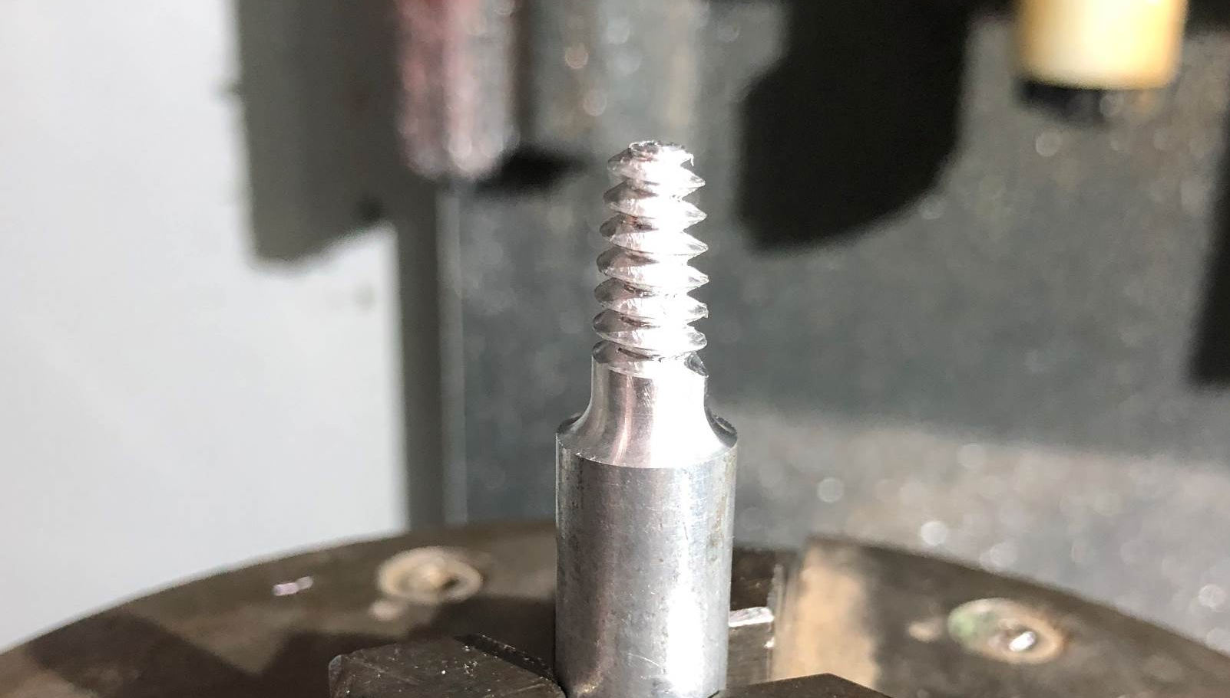
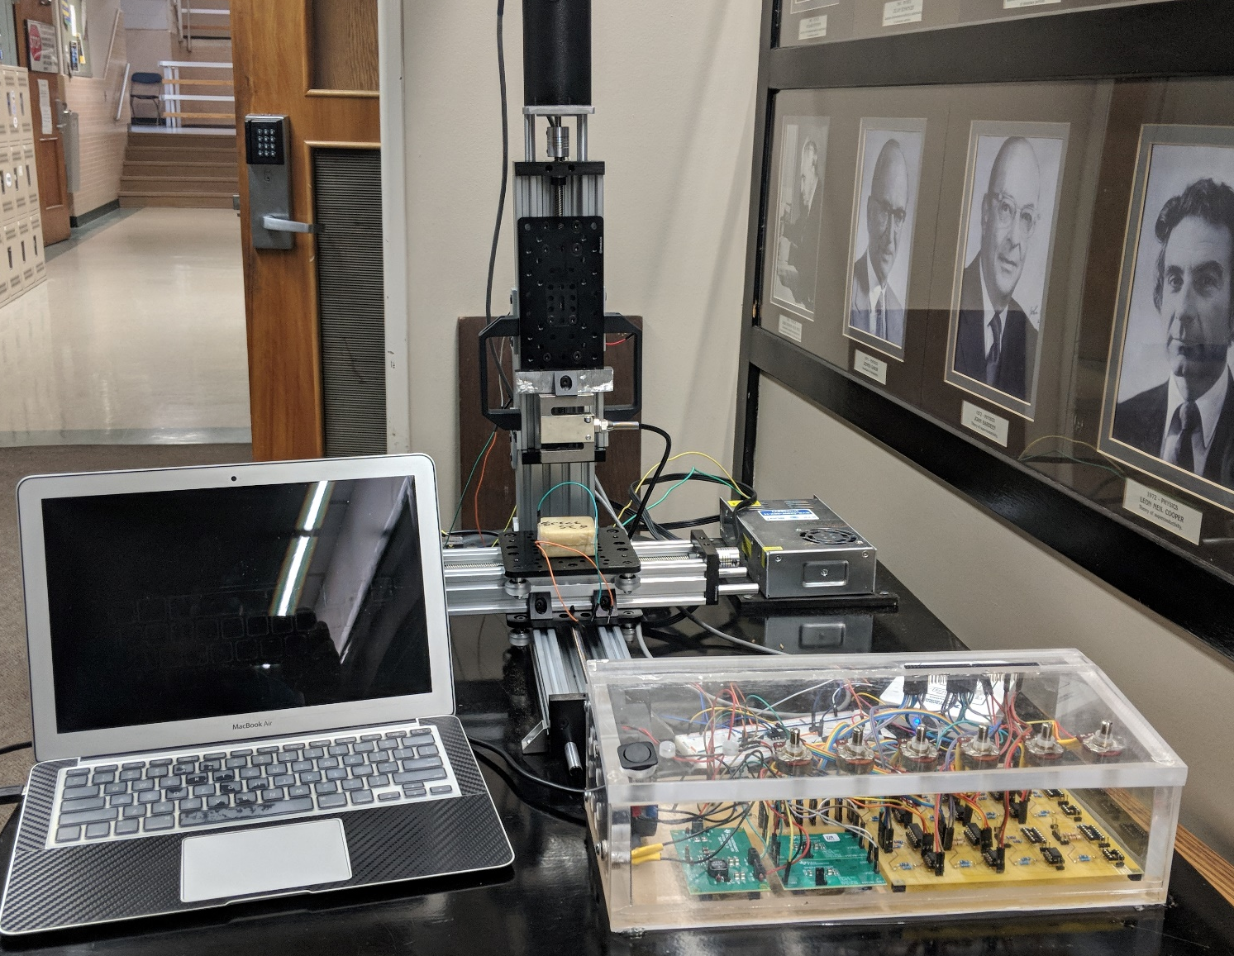
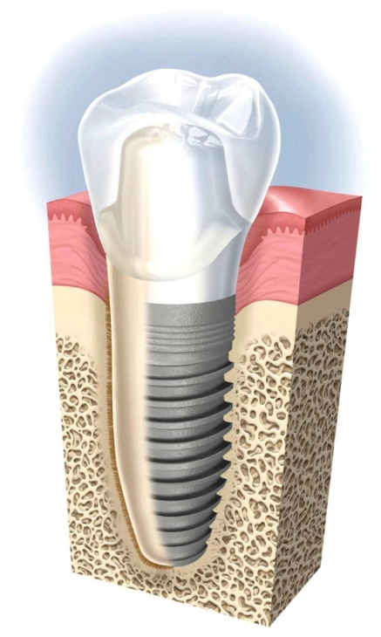
Design of an in-vitro model for testing stress distribution and stability of a single dental implant system
Amy Neal, Mohamat Eirban Ali, Paul Nuno, Danny Le, and Dr. Abdellah Ait Moussa
Department of Engineering and Physics, University of Central Oklahoma, 100 North University Drive, Edmond, OK 73034
Abstract
In a typical implant, the artificial crown is connected with the implant through an abutment unit and the implant is inserted into the host bone to replace the native root of a tooth.
These tests are important in determining the initial stability of the implant. Initial stability is important during the first three to six months after insertion into the bone. Upon initial insertion, the implant should be able to withstand at least 20 Ncm of torque to insure the implant will not move, and the bone will be able to properly grow around the implant threading. This test will be done by using a CDI torque wrench with an analog gauge seen in the figure below.
An Arduino Mega read the load cell and send the reading to another serial port which is read by the MATLAB software. In total, MATLAB was programmed with global variables that allow us to control the applied load and frequency.
Titanium alloys and ceramic are the preferred materials for dental implants. The issue here though is that, the generic dental implant design combined with the structural property of the titanium material causes dental implant to fall out early due to failure in Osseo-integration. Hence to tackle this problem, we created a software procedure that automatically designs and run simulation of large number of differently designed dental implant; the difference in dental implant are designed based on different parameter given to them.
Design & Fabrication
The strain testing system was designed using a full bridge configuration where all voltage sources were regulated in order to dramatically reduce noise. A LabView GUI allows the user to input all appropriate parameters to which the program outputs the desired strain.
A multiple software based macro we developed allowed us to configure the shape and geometry of the implant. We used a numerical optimization method to allow for needed combination that needs to be analyzed.
Deliverables
We will accomplish this through the following deliverables:
1. Design and build prototype of an in-vitro model for testing stress distribution and stability using the available CNC machine.
2. Build a torsion tester for an accurate measurement and recording of the implant insertion torque within a realistic model of the mandible bone.
3. Construct a test model to create a dynamic load testing machine simulating chewing.
4. Construct a test model for measuring stress distribution around the implant.
Figure 2. The summary of the macro control parameters.
Figure 7. Multisim Wiring Diagram
Figure 5. CDI Torque wrench used in stability test
The program utilizes a low pass filter and a moving average to further improve the accuracy of the system. It also uses the value when no force is applied as a baseline for comparison.
The pull out test ensures the implant can survive a tensile force upon initial insertion into the mandible bone. This test is performed by doing a tensile test on a Universal Testing Machine.
Background
The dynamic load testing machine was built to mimic the jaw motion during chewing. The machine was expected to be able to apply load at higher frequency than 1 Hz and at least apply 100 N. The machine functions as linear actuator controlled by a power screw powered by a servo motor. The servo motor controlled by Arduino Uno with GRBL embedded into it; the required G-Code is sent to the Uno through serial port with MATLAB software.
The loss of teeth is gradually becoming a significant public health issue with the growth of the aging population across the world, in the United States for instance the population aging 65 years and older is expected to double by 2050. Not only can the consequence of missing tooth cause retardation in chewing function, but also largely jeopardize the health status of dental bones and its associative tissues.
Figure 3. Modeling of the endosseous implant and embedding medium. The implant geometrical features (such as the thread profile) can be modified by changing the value of a design parameter within our multi-platform macro.
Figure 8. LabView Block Diagram
Future Work
Most of the testing apparatus has been successfully built, the next step is to move in to experimentation phase. Multiple dental implant needs to be tested and the data collected for analysis. For more precise prototypes of dental implants in the future, a CNC lathe will used for fabrication due to the variable changes in the thread profile. The collected data will be used in comparison to ANSYS results to make sure the validity of the macro design process.
Crown
Gum
Cortical Bone
Tooth Root
Dental Implant
Figure 4. A dental implant prototype in-progress cut in CNC Machine.
Jawbone
Cancellous Bone
Project Outcomes
Figure 1: The cross-sectional overview of a dental implant.
We will design a machine that can measure and record the torque applied during the insertion of the implant into a realistic model of mandible bone, as well as a pull out test.
Acknowledgements
When adjacent teeth do not allow construction of a fixed partial denture (or namely dental bridge), dental implant may be the only option for restoration.
Special acknowledgement to Dr. Khandaker, Dr. Moussa, Dr. Alsbou, Office of High Impact Practices, and UCO Engineering Department.
Figure 6. Dynamic Load tester with strain gage system.

